Slide 1
Catapult
苏凡凡
2024.10.21

Slide 2
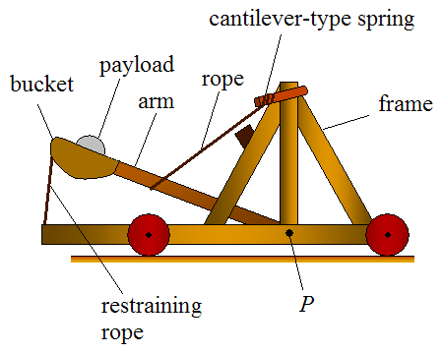
Summary
grade range: 6th-8th
group size: 2-4 students
active time: 1-2 hours
area of science:
physics
engineering challenge

Slide 3
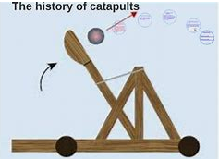
Background
A catapult is a mechanical device that launches things by storing and releasing potential energy. Originally used in ancient warfare, catapults are now popular in education for teaching physics concepts like force and motion.

Slide 4
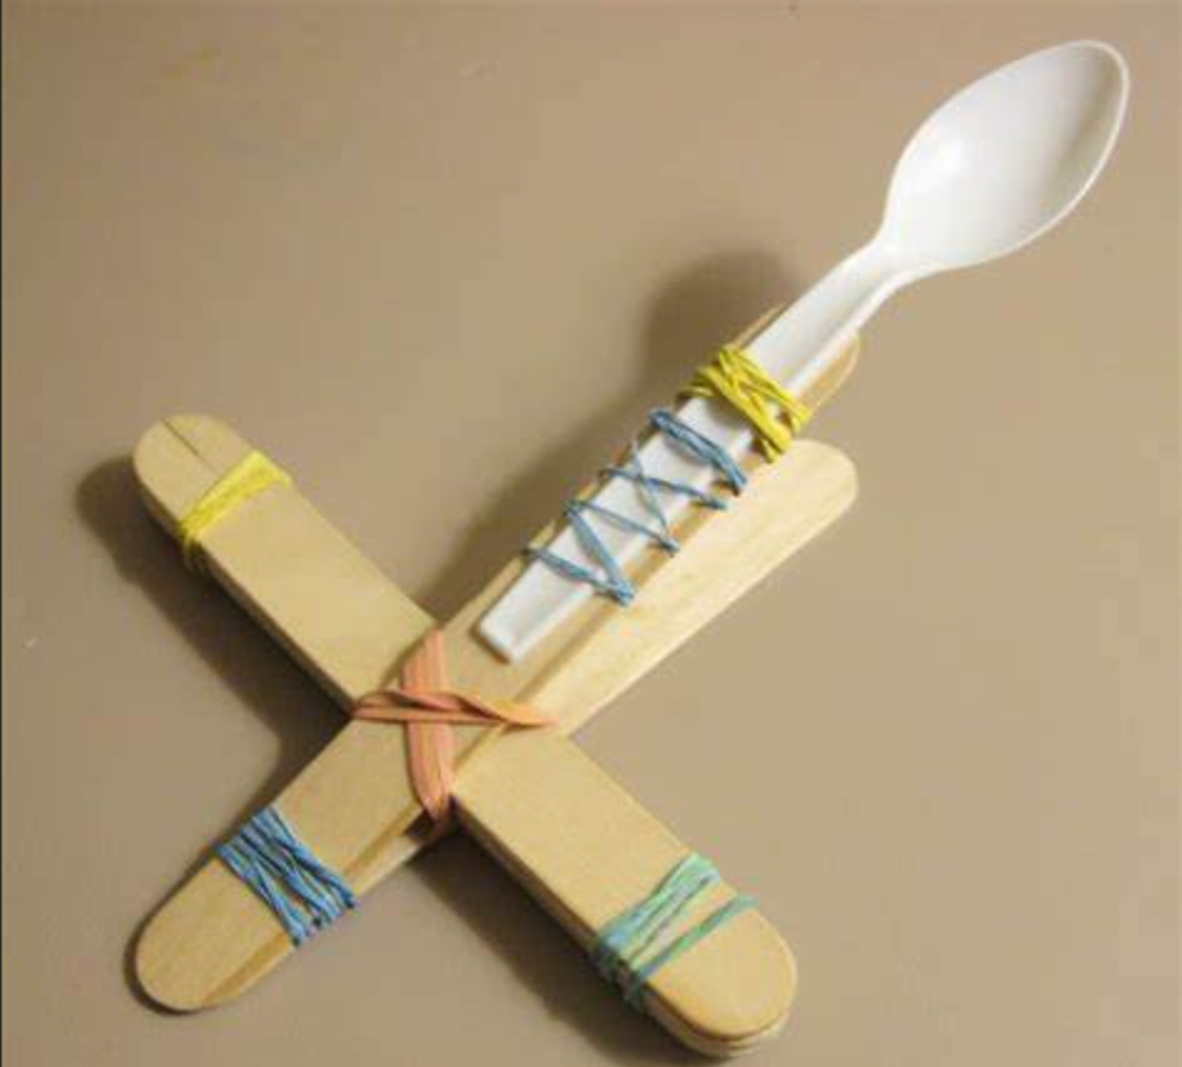
Overview
Students will design and build a functional catapult using only basic materials such as paper and tape. However, there's an additional challenge to this classic activity. The catapult must be capable of launching a small object a certain distance while maintaining stability and structural integrity!

Slide 5
Learning objects
Design and build a paper tower based on specific criteria.
lteratively test and modify the tower to improve its performance.

Slide 6
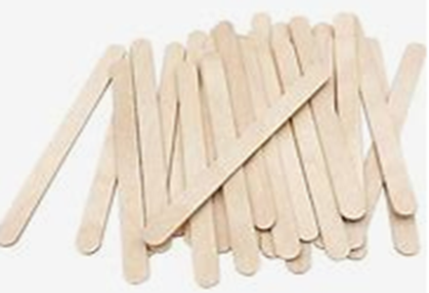
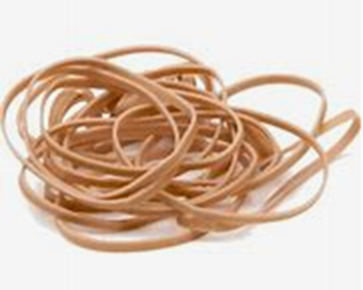
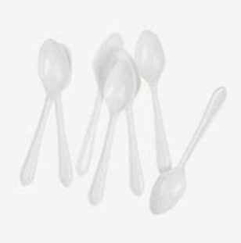

Materials
Plastic Spoons – for the launching arm or bucket.
Popsicle Sticks – for the frame and arms
Rubber Bands – to create tension for launching.
Small ball or paper – as the projectile.

Slide 7
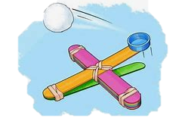
Introduction（10min）
What is a catapult?
A catapult is a mechanical device used to launch objects into the air using stored tension or force. It operates by releasing stored potential energy to hurl a projectile over a distance, often for siege warfare in ancient times or for educational purposes in physics experiments.

Slide 8
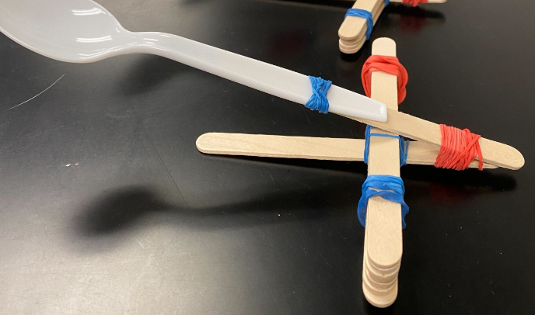

Experiment（40min）
Prepare the
Object
Load the small ball or crumpled paper into the spoon of the launching arm.
Create the Tension Force
Place the other end of the popsicle stick on top of the vertical supports and secure it with a rubber band to form a pivot point.
Assemble the Launching Arm
Attach the plastic spoon to one end of a popsicle stick using a rubber band to serve as the launching arm.
Build the Base
Create a sturdy base by stacking 3-4 popsicle sticks and securing both ends with rubber bands.
5
Gather Materials
Collect 5-7 popsicle sticks, 2-3 rubber bands, 1 plastic spoon, and a small ball or crumpled paper for the projectile.
4
3
2
1

Slide 9

Questions
What happened to the object when you increased the tension on the launching arm?
How did the angle of the launching arm affect the distance the object traveled?

Slide 10
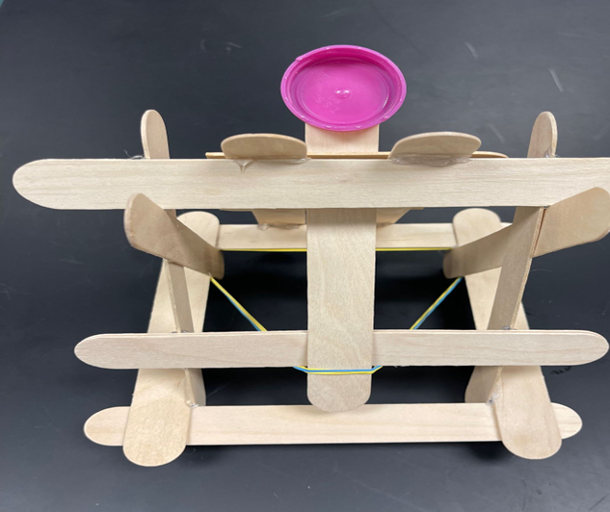
Assessment（5min）
Did the catapult meet the design requirements ？
(e.g., use sticks, rubber bands, and a spoon）
How far did the object travel?
Was the structure stable during the test?

Slide 11
Reflection（10min）
Students actively engage in building and testing the catapult, fostering deeper understanding of forces and motions.
Students explore design options and experiment with modifications to improve performance.
To design challenging model tasks based on different students’ learning levels.

Slide 12
Standard
Motion and Stability: Forces and Interactions
Through the topic we are aiming to tell students about motion and stability,
especially forces and interactions using catapult models.

Slide 13
Thank you ！

